Slide 1

HTTP Protocol​
Handling Requests, ​ Constructing Responses, HTTP/2 & HTTP/3
SoftUni Team
Technical Trainers
Software University
https://softuni.bg

Slide 2
Questions?
sli.do
#csharp-web

Slide 3
Table of Content
HTTP Basics
URL
HTTP Request
HTTP Response
MIME and Media types
Routing in Web
HTTP Dev Tools
Web Server
HTML Forms
HTTP/2
HTTP/3

Slide 4

HTTP Basics​
Basic Concepts

Slide 5
What is a Protocol?
A communication protocol == set of rules, which define how two or more parties are talking to each other
It is like a common language used for communication between machines

Slide 6


Hyper Text Transfer Protocol
Request
Response
HTTP
HTTP
TCP
TCP
IP
IP
Media (wires / air / fiber)
Ethernet
Ethernet
Notes:
HTTP == Hyper Text Transfer Protocol
Client-server protocol for transferring Web resources (HTML files, images, styles, scripts, data, etc.)
The widespread protocol for Internet communication today
Request-response model (client requests, server answers)
Text-based format (human readable)
Relies on unique resource URLs
Provides resource metadata (e.g. encoding)
Stateless (cookies and Web storages can overcome this)

Slide 7
HTTP Protocol
HyperText Transfer Protocol
Text-based client-server protocol
General-purpose client-server protocol used to transmit data across the web
For transferring Web resources (HTML files, images, styles, etc.)
Relies on URLs

Slide 8

HTTP Protocol
Stateless
Each HTTP request is independent from the others
Cookies and Web storages can overcome this
Uses the request-response model
HTTP request
HTTP response
Web Client
Web Server

Slide 9
HTTP Conversation: Example
GET /courses/javascript HTTP/1.1
Host: www.softuni.bg
User-Agent: Mozilla/5.0
<CRLF>
HTTP request
HTTP response
The empty line denotes the end of the request header
HTTP/1.1 200 OK
Date: Mon, 5 Jul 2020 13:09:03 GMT
Server: Microsoft-HTTPAPI/2.0
Last-Modified: Mon, 12 Jul 2014 15:33:23 GMT
Content-Length: 54
<CRLF>
<html><title>Hello</title>
Welcome to our site</html>
The empty line denotes the end of the response header

Slide 10

URL
Uniform Resource Locator

Slide 11
Uniform Resource Locator (URL)
http://mysite.com:8080/demo/index.php?id=27&lang=en#slides
Protocol
Host
Port
Path
Query string
Fragment
URL == formatted string, consisting of
Network protocol (http, ftp, https...) – HTTP in most cases
Host or IP address (softuni.org, gmail.com, 127.0.0.1, web)
Port (the default port is 80) – integer in the range [0…65535]
Path (/forum, /path/index.php)
Query string (?id=27&lang=en)
Fragment (#slides) – navigate to some section in the page

Slide 12
URL Encoding
URLs are encoded according RFC 1738
Safe URL characters: [0-9a-zA-Z], $, -, _, . , +, *, ', (, ), ,, !
All other characters are escaped by
Space is encoded as "+" or "%20"
URL-encoded string
Char | URL Encoding
space | %20
щ | %D1%89
" | %22
# | %23
$ | %24
% | %25
& | %26
%[character hex code]
Наков-爱-SoftUni
%D0%9D%D0%B0%D0%BA%D0%BE%D0%B2-%E7%88%B1-SoftUni

Slide 13
Valid and Invalid URLs – Examples
Some valid URLs
Some invalid URLs
http://www.google.bg/search?sourceid=navclient&ie=UTF-8&rlz=1T4GGLL_enBG369BG369&q=http+get+vs+post
http://bg.wikipedia.org/wiki/%D0%A1%D0%BE%D1%84%D1%82%D1%83%D0%B5%D1%80%D0%BD%D0%B0_%D0%B0%D0%BA%D0%B0%D0%B4%D0%B5%D0%BC%D0%B8%D1%8F
Should be ?q=C%23+.NET+6.0
http://www.google.bg/search?&q=C# .NET 6.0
Should be ?q=%D0%B1 %D0%B8%D1%80%D0%B0
http://www.google.bg/search?&q=бира

Slide 14

HTTP Request​
What is a HTTP Request?

Slide 15
HTTP Request Message
Request message sent by a client consists of
HTTP request line
Request method (GET / POST / PUT / DELETE / …)
Resource URI (URL)
Protocol version
HTTP request headers
Additional parameters
HTTP request body – optional data, e.g., posted form fields
<method> <resource> HTTP/<version>
<headers>
(empty line)
<body>

Slide 16







HTTP Request Methods
HTTP defines methods to indicate the desired action to be performed on the identified resource
CRUD == the four main functions of persistent storage
Method | Description
GET | Retrieve a resource
POST | Create / store a resource
PUT | Update (replace) a resource
DELETE | Delete (remove) a resource
PATCH | Update resource partially (modify)
HEAD | Retrieve the resource's headers
Other Methods
CONNECT
OPTIONS
TRACE

Slide 17
HTTP GET Request
GET is used to request data from a specified resource
Example of HTTP GET request
GET /index.html HTTP/1.1
Host: localhost
<CRLF>
HTTP request line
HTTP request headers
HTTP request body is empty

Slide 18
HTTP POST Request
The POST method transfers data in the HTTP body
Example of HTTP POST request
HTTP request line
POST /login.html HTTP/1.1
Host: localhost
Content-Length: 59
Content-Type: application/x-www-form-urlencoded
<CRLF>
username=testUser&password=topSecret
<CRLF>
HTTP request headers
HTTP request body holds the submitted form data

Slide 19

HTTP Response​
What is a HTTP Response?

Slide 20
HTTP Response Message
The response message sent by the HTTP server consists of
HTTP response status line
Protocol version
Status code
Status phrase
Response headers
Provide meta data about the returned resource
Response body
The content of the HTTP response (data)
HTTP/<version> <status code> <status text>
<headers>
(empty line)
<response body – the requested resource>

Slide 21
HTTP Response – Example
HTTP response status line
HTTP/1.1 200 OK
Date: Fri, 17 Jul 2020 16:09:18 GMT+2
Server: Apache/2.2.14 (Linux)
Accept-Ranges: bytes
Content-Length: 84
Content-Type: text/html
<CRLF>
<html>
<head><title>Test</title></head>
<body>Test HTML page.</body>
</html>
HTTP response headers
HTTP response body

Slide 22
HTTP Response Status Codes
HTTP response code classes
1xx: informational (e.g., "100 Continue")
2xx: successful (e.g., "200 OK", "201 Created")
3xx: redirection (e.g., "304 Not Modified", "301 Moved Permanently", "302 Found")
4xx: client error (e.g., "400 Bad Request", "404 Not Found", "401 Unauthorized", "409 Conflict")
5xx: server error (e.g., "500 Internal Server Error", "503 Service Unavailable")

Slide 23
HTTP Error Response – Example
HTTP response status line
HTTP/1.1 404 Not Found
Date: Fri, 17 Nov 2020 16:09:18 GMT+2
Server: Apache/2.2.14 (Linux)
Connection: close
Content-Type: text/html
<CRLF>
<html><head><title>404 Not Found</title></head>
<body>
<h1>Not Found</h1>
<p>The requested URL /img/logo.gif was not found on this server.</p> <hr><address>Apache/2.2.14 Server at Port 80</address>
</body></html>
HTTP response headers
HTTP response body

Slide 24
Browser Redirection
HTTP GET requesting a moved URL
The following HTTP response (301 Moved Permanently) tells the browser to request another URL
GET / HTTP/1.1
Host: http://softuni.org
User-Agent: Gecko/20100115 Firefox/3.6
<CRLF>
HTTP/1.1 301 Moved Permanently
Location: http://softuni.bg
…

Slide 25
Content-Type and Disposition
The Content-Type response header specifies how the output should be processed
Examples
UTF-8 encoded HTML page. Will be shown in the browser.
Content-Type: text/html; charset=utf-8
Content-Type: application/pdf
Content-Disposition: attachment; filename="Report-April-2020.pdf"
This will download a PDF file named Report-April-2020.pdf

Slide 26

MIME and Media Types
Multi-Purpose Internet Mail Extensions

Slide 27
What is MIME?
MIME == Multi-Purpose Internet Mail Extensions
Internet standard for encoding resources
Originally developed for email attachments
Used in many Internet protocols like HTTP and SMTP
MIME defines several concepts
Content-Type, e.g. text/html, image/gif, application/pdf
Content charset, e.g. utf-8, ascii, windows-1251
Content-Disposition, e.g. attachment; filename=logo.jpg
Multipart messages (multiple resources in a single document)

Slide 28
Common MIME Media Types
MIME Type / Subtype | Description
application/json | JSON data
image/png | PNG image
image/gif | GIF image
text/html | HTML
text/plain | Text
text/xml | XML
video/mp4 | MP4 video
application/pdf | PDF document

Slide 29
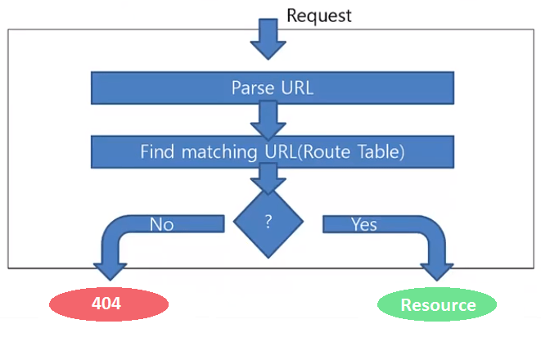
Routing
Mapping HTTP Request to HTTP Responses

Slide 30
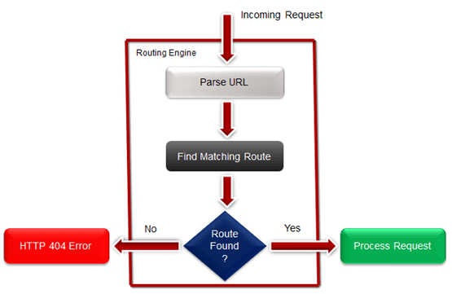
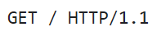
What is Web Routing?
Web Routing is a mechanism where HTTP requests are routed to the code that handles them
Requests are routed based on the HTTP
request method and the request path
HTTP requests are mapped
to HTTP responses
Example: route "/" is often
mapped to the app's Home page

Slide 31
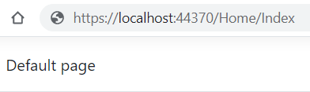
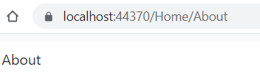
Mapping Physical Files
RouteTable.Routes.MapPageRoute
Route Name | Route URL | Physical File Name
Home | Home/Index | Index.html
About | Home/About | About.html
User-friendly URL replacement of the physical file name
void RegisterRoutes(RouteCollection routes)
{
routes.MapPageRoute("Home","Home/Index","/wwwroot/Home/Index.html");
routes.MapPageRoute("About","Home/About","/wwwroot/Home/About.html");
}

Slide 32

HTTP Tools
Tools for Developers

Slide 33
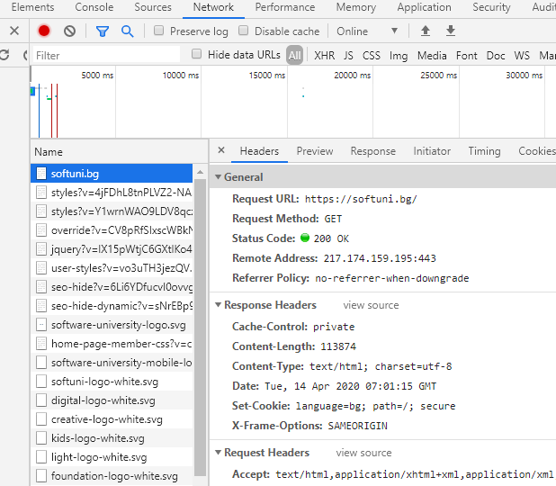
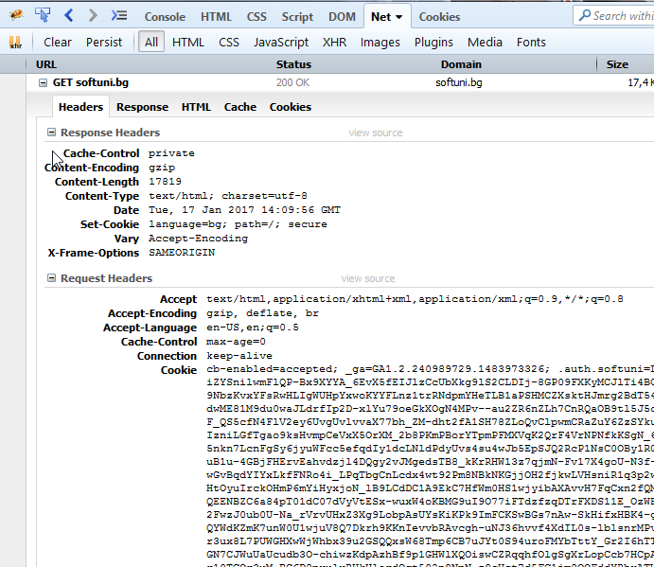
HTTP Tools for Developers – Browser
Chrome Developer Tools
Firebug

Slide 34



HTTP Tools for Developers
Insomnia Rest
Postman
RESTClient

Slide 35




Web Server

Slide 36

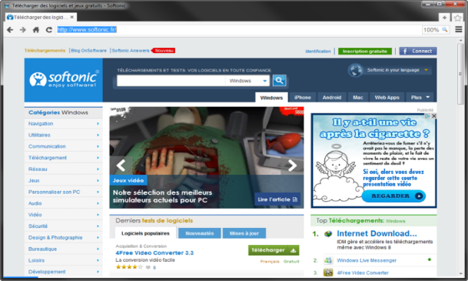



What is a Web Server?
Computer system that processes requests via HTTP, the basic network protocol
Web Client
Web Server
Communication

Slide 37

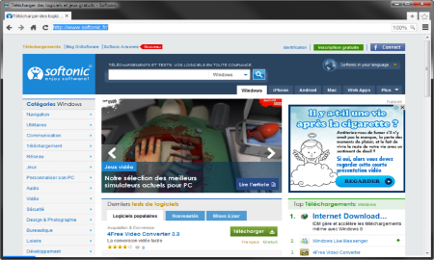
Web Server Work Model
Web Server
Web Resources
Web Client
Request
Protocol
Response
HTML, PDF, JPG…
Protocols:
HTTP FTP WebSocket
Protocol
Host
Port
Resource
URL
http://localhost:8000/softuni.jpg

Slide 38



Web Server Work Model
Web Server
Technology
Web Client
Request
Protocol
Response
Web Resources
Database
HTML, PDF, JPG…

Slide 39


Web Server Work Model
Web Server
Technology
Spring
Web Resources
Database
HTML, PDF, JPG…

Slide 40
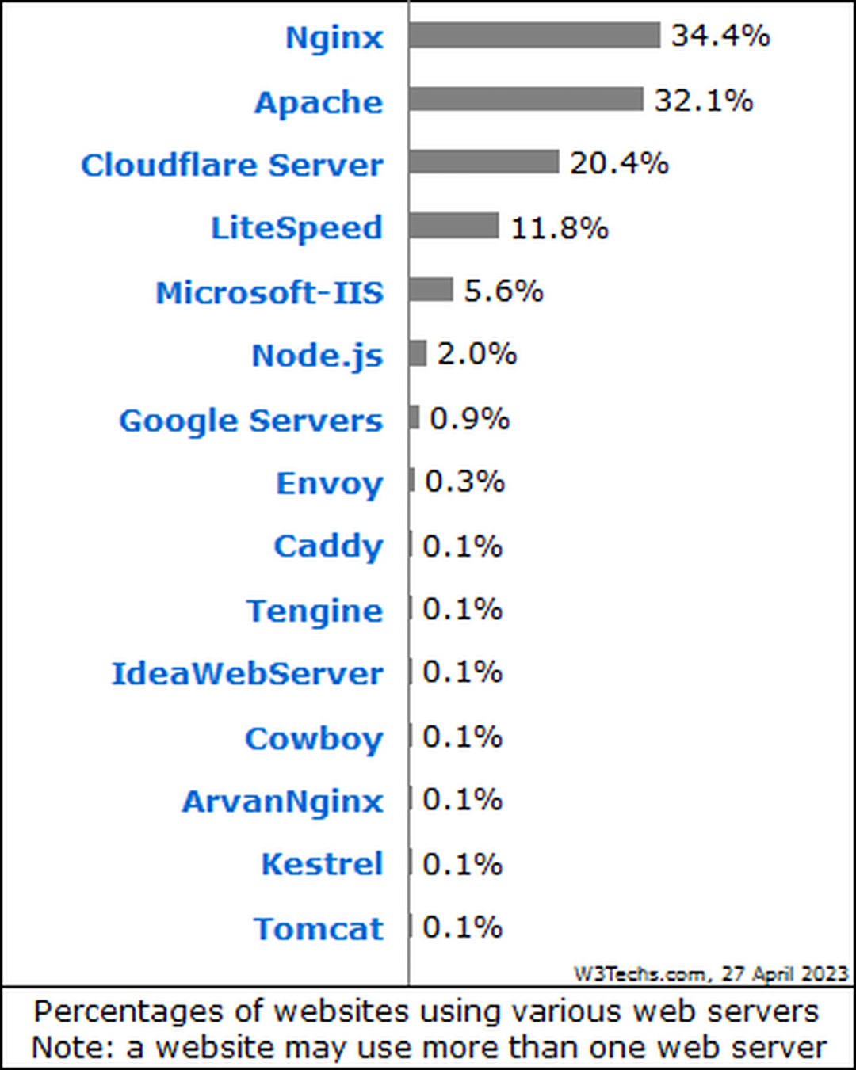

Most Popular Web Servers (W3Techs)

Slide 41



HTML Forms
Form Method and Action

Slide 42


HTML Forms – Action Attribute
Defines where to submit the form data
<form action="home.html">
<input type="submit" value="Go to homepage"/>
</form>

Slide 43
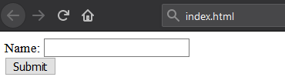
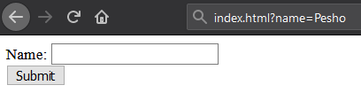
HTML Forms – Method Attribute
Specifies the HTTP method to use when sending form data
<form action="/" method="get"> Name: <input type="text" name="name"> <br>
<input type="submit" value="Submit">
</form>
The form data is in the URL

Slide 44
HTML Forms – Method Attribute
<form action="/" method="post"> Name: <input type="text" name="name"> <br>
<input type="submit" value="Submit">
</form>
POST http://localhost/index.html HTTP/1.1
Host: localhost
Content-Type: application/x-www-form-urlencoded
Content-Length: 10
name=Pesho
HTTP request body holds the form data

Slide 45
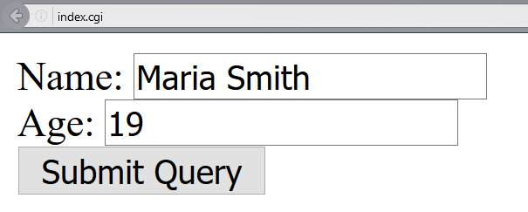
URL Encoded Form Data – Example
<form action="/" method="post">
Name: <input type="text" name="name"/> <br/>
Age: <input type="text" name="age"/> <br/>
<input type="submit" />
</form>
POST http://localhost/cgi-bin/index.cgi HTTP/1.1
Host: localhost
Content-Type: application/x-www-form-urlencoded
Content-Length: 23
name=Maria+Smith&age=19
File uploads are not supported

Slide 46
GET vs. POST Method
GET
Values are contained in the URL
Has a length limitation of 255 characters
It is often cacheable
Supports only string data types
Parameters are saved in browser history
Results can be bookmarked
POST
Values are contained in the message's body
Does not have a length limitation
It is hardly cacheable
Supports different data types
Parameters are not saved in browser history
Results cannot be bookmarked

Slide 47

HTTP/2
What's HTTP/2? What's New? What's Better?

Slide 48

What's HTTP/2
HTTP/2 (originally named HTTP/2.0) is a major revision of the HTTP network protocol used by the World Wide Web
Supported by most of the popular web browsers (Chrome, Mozilla, Opera, ...)
Fast & optimized
Meets modern web usage requirements
Completely Backwards-Compatible
As of Apr 2023, 40% of all the websites support HTTP/2 (W3Techs statistics)

Slide 49

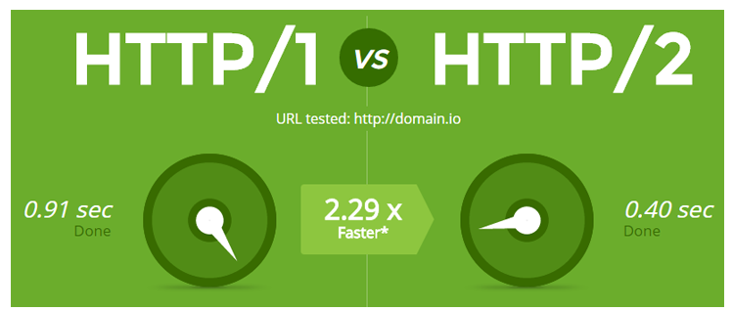
What's New?
HTTP/2 is meant to erase the need of maintaining complex server infrastructures in order to perform well
HTTP/2 communicates in binary data frames
HTTP/2 introduces several new important elements
HTTP/2 Multiplexing
HTTP/2 Header Compression
HTTP/2 Server Push

Slide 50
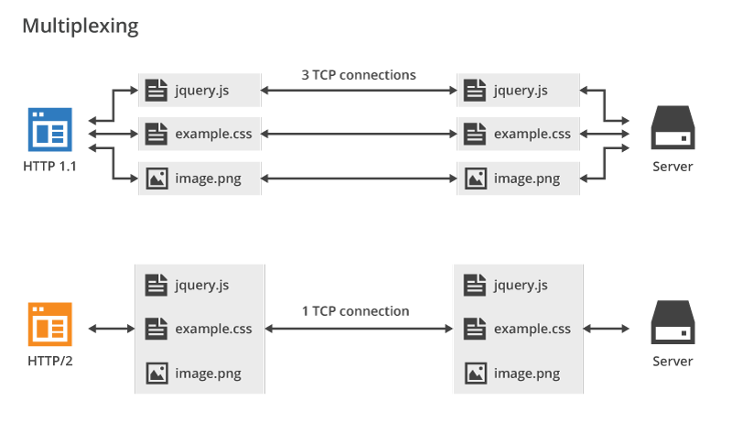
HTTP/2 Multiplexing
The art of handling multiple streams over a single TCP connection

Slide 51
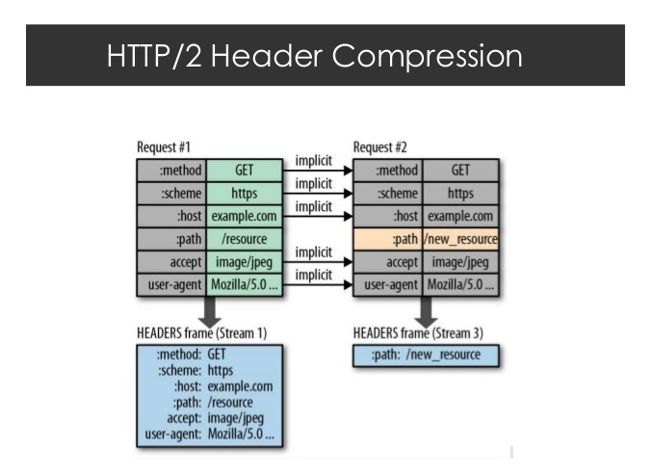
HTTP/2 Header Compression
HTTP/2 maintains a HTTP Header Table across requests
Optimizes communication drastically
The process is essentially a de-duplication, rather than compression
HTTP/2

Slide 52
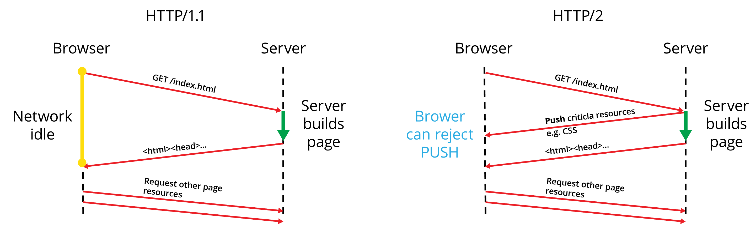
HTTP/2 Server Push
HTTP/2 Server Push == the process of sending resources to clients, without them having to ask for it

Slide 53

HTTP/3
What's HTTP/3

Slide 54

What's HTTP/3
HTTP/3 is a new standard in development that will affect how web browsers and servers communicate
As of Apr 2023, HTTP/3 is supported by 26% of web browsers (W3Techs statistics)
Uses QUIC Protocol

Slide 55
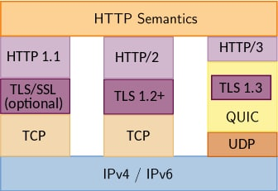
What's new?
Significant upgrades for user experience
Decreasing the effects of packet loss
Workaround for the slow performance, e. g., when a smartphone switches from Wi-Fi to cellular data
Performance, Reliability and Security

Slide 56

Summary
…
…
…
HTTP
HTML Forms & Actions
URLs
Request & Response
MIME & Media Types
Web Server
Web Communication

Slide 57









Questions?

Slide 58










SoftUni Diamond Partners

Slide 59
Trainings @ Software University (SoftUni)
Software University – High-Quality Education, Profession and Job for Software Developers
softuni.bg, about.softuni.bg
Software University Foundation
softuni.foundation
Software University @ Facebook
facebook.com/SoftwareUniversity
59
Notes:
59

Slide 60

License
This course (slides, examples, demos, exercises, homework, documents, videos and other assets) is copyrighted content
Unauthorized copy, reproduction or use is illegal
© SoftUni – https://about.softuni.bg/
© Software University – https://softuni.bg
Notes:
60

